Slide 1
Information Visualization Visualization Sketch
G01-A
70493 – Tiago Nascimento
76102 – Miguel Cruz
76394 – Daniel Trindade

Slide 2
Visual encoding
01

Slide 3

Visual Encoding – 1
Ranks

Slide 4
Visual Encoding – 1
Ranks – bar chart
Type:
Length – amount of medals or the medals/population coefficient
Position – one for each country

Slide 5
Visual Encoding – 1
Ranks
Visual Encoding:
USA
92
China
75
Italy

Slide 6
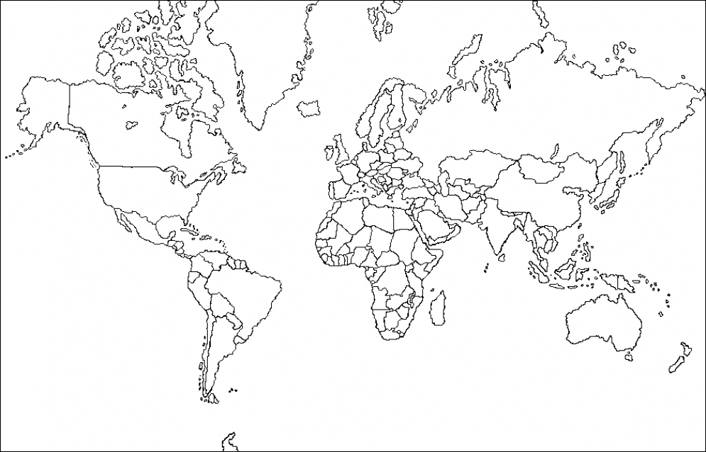
Visual Encoding – 2
A scatter plot over a map

Slide 7
Visual Encoding – 2
A map
Type:
Size/Area – amount of medals or the medals/population coefficient
Position – corresponds to the location of the country on the map

Slide 8
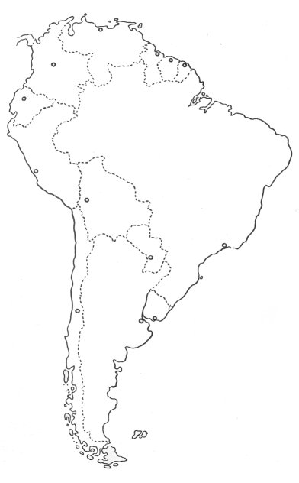
Visual Encoding – 2
A map
Visual Encoding:
2
32
14

Slide 9

Visual Encoding – 3
Compare results

Slide 10
Visual Encoding –3
Compare results

Slide 11
Visual Encoding – 3
Compare results - additions
Type:
Colors – to distinguish the two countries

Slide 12
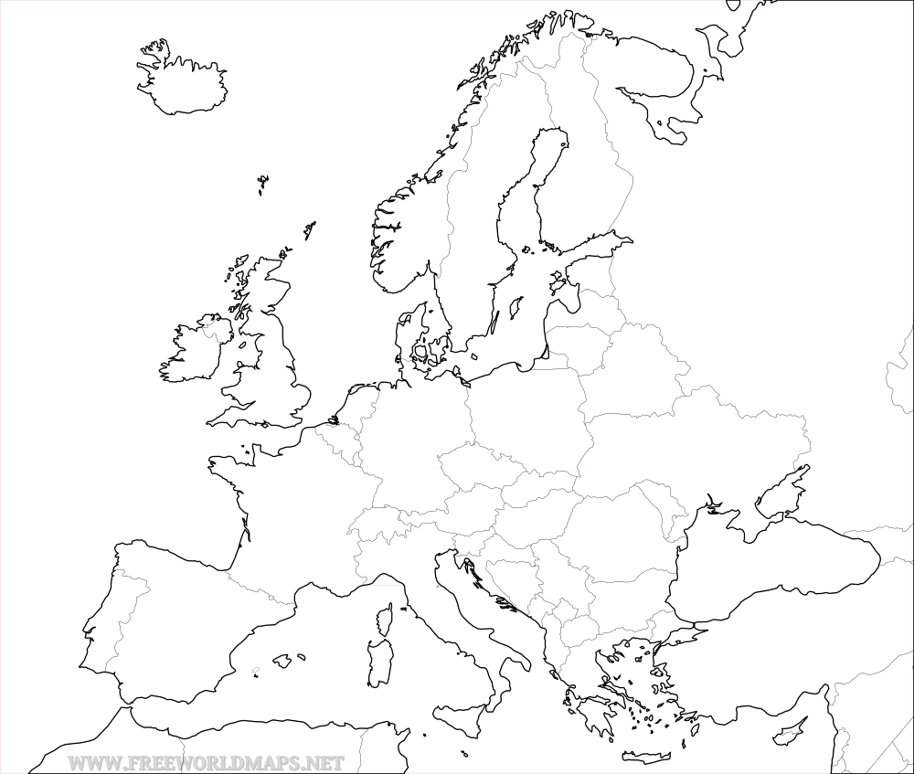
Visual Encoding – Item 3
Compare result
Visual Encoding:
VS
Brazil
Portugal

Slide 13
Visual Encoding – Item 3
Compare result
Visual Encoding:
All Sports
94
32
Judo
17
2
…

Slide 14
IDIOM – tasks/questions mapping
02

Slide 15
Task 1
Selected Idiom and why it allows answering each question

Slide 16
Task 2
Selected Idiom and why it allows answering each question

